Slide 1


EOSC EDEN
Enhancing Digital preservation strategies at European and National level
Grant agreement 101188015

Slide 2
EOSC EDEN Key Facts
Project full title: | EOSC EDEN - Enhancing Digital preservation strategies at the European and National level
Funding: | Horizon Europe, Grant agreement ID: 101188015
Project type: Budget: | Research and Innovation Action (RIA) 8M €
Coordinator: | CSC – IT Center for Science, Finland
Project start and end date: | 1 Jan 2025 - 31 Dec 2027

Slide 3
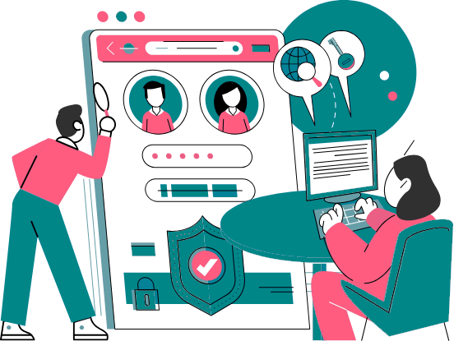
EOSC EDEN Project
Summary
The EOSC EDEN project is funded by the European Union under the Horizon Europe framework programme and aims to support and promote digital preservation practices and standards at the European and national levels.
This support will be complemented by the development of user-centric tools, services, and standards designed to facilitate the creation of a distributed European infrastructure for digital data preservation, retention, and access.
These tools will be developed following extensive stakeholder engagement encompassing individuals, groups, and organisations with an interest in or influence on, the project's development, implementation, and outcomes.

Slide 4
Why is EOSC EDEN needed?
To ensure that digital objects remain understandable and usable to their community of users
Costs and physical limitations of storage and service capacity lead to the difficult question of what is worthy of digital preservation.
Awareness and implementation of preservation practices and standards are uneven across scientific disciplines and communities, which can cause fragmentation and interoperability challenges.
Data curation and preservation are essential processes to guarantee quality of data, especially over time, but costs associated with the long-term benefits can be difficult to justify.

Slide 5
EOSC EDEN Objectives
Objective 1: To establish a general framework and practices to support the creation of curation, digital preservation, and access strategies in Europe
Objective 2: To enrich EOSC with tools to store and access digital data for long periods, automate and federate certain specialised curation and preservation tasks
Objective 3: To increase adoption of curation, digital preservation and access practices within different scientific disciplines
Objective 4: To boost the data curation and quality in Europe
Objective 5: To identify and consolidate a network of repositories and archives for digital preservation within EOSC in collaboration with the HORIZON-INFRA-2024-EOSC-01-03 awarded project i.e. FIDELIS

Slide 6
Project Structure and Work Packages
WP5 Coordination, Sustainability and Strategic Alignment
WP1 Data and Process Framework for Digital Preservation
WP2 Long-term Access and Preservation Services & Tools
WP3 Discipline-specific Requirements, Validation and Future Use
WP4 Expert & Community Engagement

Slide 7





Project Structure and Work Packages
WP5 Coordination, Sustainability and Strategic Alignment
WP1 Data and Process Framework for Digital Preservation
WP2 Long-term Access and Preservation Services & Tools
WP3 Discipline-specific Requirements, Validation and Future Use
WP4 Expert & Community Engagement

Slide 8
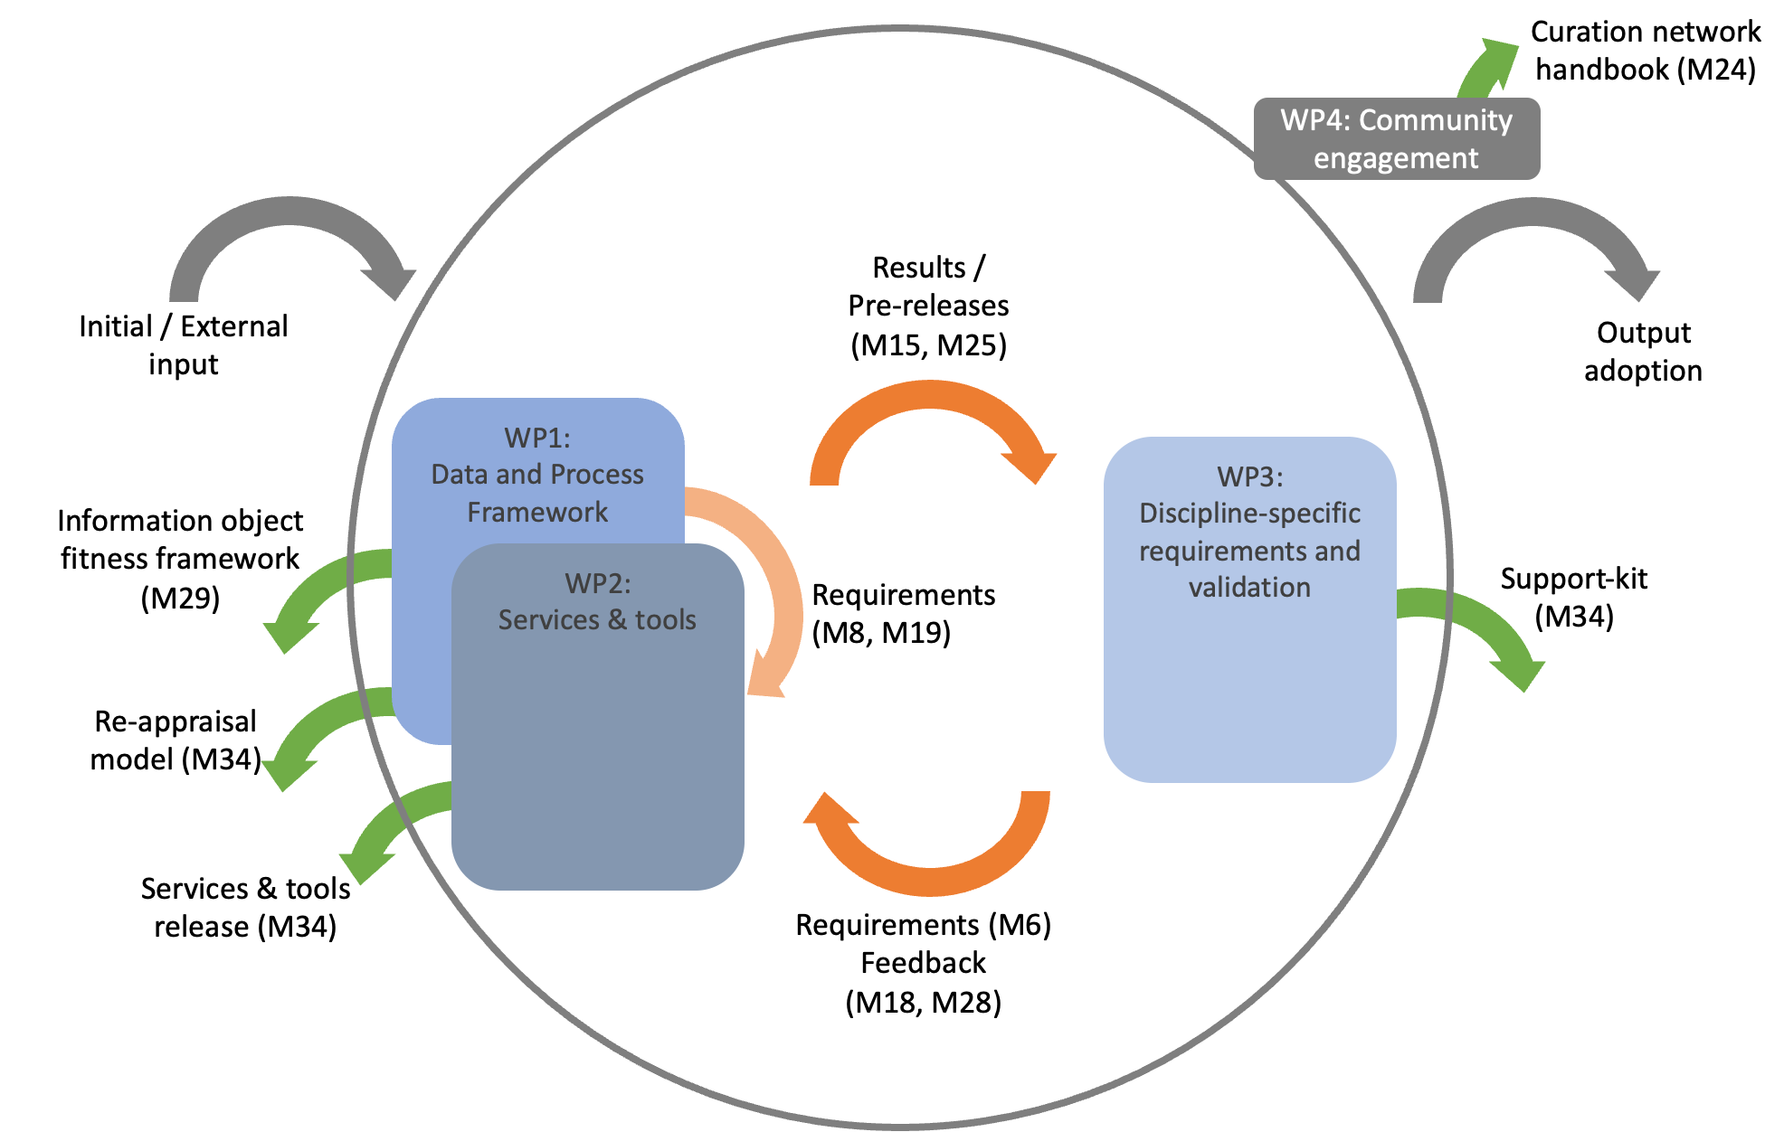
Iterative Development
Year 1
M1 Jan 2025
M6 Jun 2025
M12 Dec 2025
Year 2
M13 Jan 2026
M18 Jun 2026
M24 Dec 2026
Year 3
M25 Jan 2027
M30 Jun 2027
M36 Dec 2027

Slide 9
Work Packages & Expected Results

Slide 10
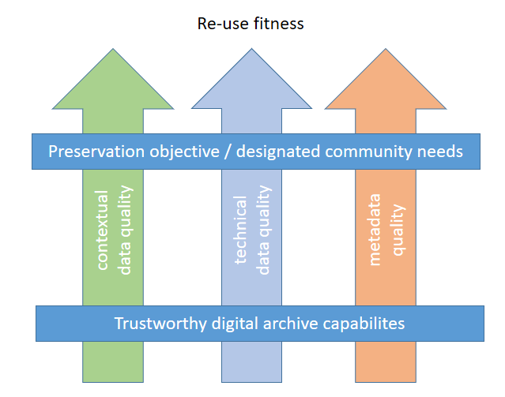
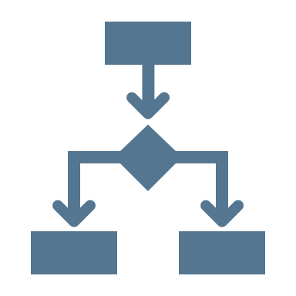




WP1 Data and Process Framework for Digital Preservation
Develops processes as requirements for implementation (WP2) and community adoption (WP3, WP4)
Existing practices for identification, selection and appraisal of data for digital preservation
Requirements in digital preservation processes for
re-use fitness of digital objects
Framework to identify candidates to digital preservation based on use, benefit and quality
Model for re-appraisal points along data lifecycle

Slide 11
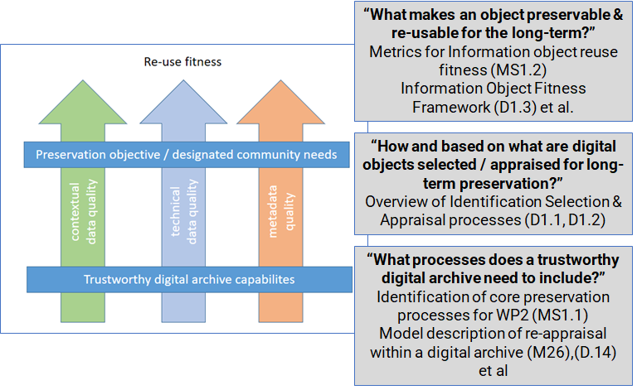

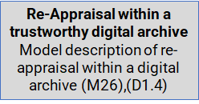
WP1 Expected Results

Slide 12





WP2 Long-term Access and Preservation Services & Tools
Delivers reference implementations and supporting tools to integrate
repositories and services into the EOSC Federation
Registry of digital preservation services and tools
Publish machine-interoperable services for curation and preservation actions
Identify standards and protocols for submit and exchange Information packages
Use case implementation and testing of services and tools

Slide 13
WP2 Expected Results
Searchable Registry (EOSC EDEN Registry) of repositories and services, including LTP services.
Guidance and Selection on repository characteristics/attributes
Inventory of automated Curation Services, e.g. format guidance, type guidance, etc.
Specifications of Information Packages for exchange
Establish well-defined use cases (discipline-specific) for services, e.g. different LTP- and repository services types
Reference Implementations where possible

Slide 14




WP3 Discipline-specific Requirements,
Validation and Future Use
Links the project to discipline and data-type specific needs and requirements
Iteratively provide discipline-specific, and cross-disciplinary / data type-specific requirements for digital preservation and data quality to WP1 and WP2
Validate and enhance the new digital preservation framework (WP1) and tools (WP2) via pilot testing
Provide a support-kit to empower discipline and data type-oriented communities to adopt, extend and use the new digital preservation framework (WP1) and fit-for-purpose tools (WP2)

Slide 15














Discipline-oriented pilots
Social Sciences
Earth & Environmental Sciences
Requirements and needs from disciplinary perspective
Testing and validation
Early adoption
Support kit to endorse wider adoption of the project results
Food Sciences
Climate Simulations
High-Energy Physics
Life Sciences and Bioinformatics
Linguistics

Slide 16
WP3 Expected Results
Ensure that the project outcomes are adopted by the involved disciplines and digital object-type communities:
Project Objective | Outcome | Role of WP3
1. Establish Framework | a. Framework to identify data candidates for LTP b. Model for re-appraisal of data c. Set of practices and standards to support LTP strategies | Ensure the framework and tools support needs and requirements from disciplines and digital object type communities
2. Provide tools | Reference implementations and APIs for three groups of operational services
3. Promote adoption | Support-kit targeted to discipline and data type-oriented communities | Develop support-kit
4. Boost data curation and quality | a. Expert curation network is established. b. Best practices are disseminated in EOSC. c. Two curation schools are organised. d. Collaboration is established with related projects. | Ensure representation of disciplines and digital object type communities

Slide 17




WP4 Expert & Community Engagement
Support the other WPs in effectively engaging with communities and experts
Gather input and feedback during the development, testing and validation cycles
Increase awareness, knowledge and uptake of long-term preservation actions and processes in the EOSC ecosystem
Identify and consolidate a network of service providers

Slide 18








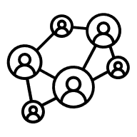

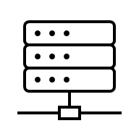
EOSC Ecosystem
Funders
TDAs & TDRs
Policymakers
International Organisations & Initiatives
EOSC EDEN
Key Stakeholders
GLAM Sector
Discipline-Specific Communities
Data Spaces
National Networks
Research Performing Organisations
Research Infrastructures

Slide 19




WP5 Coordination, Sustainability and Strategic Alignment
Project coordination and management incl. content work, finance & administration
Liaison with the External Advisory Board
Strategic alignment with the EOSC Partnership and other relevant strategic initiatives
Sustainability and exploitation of the project results

Slide 20
EOSC EDEN Impact
Specific project impacts
Increased awareness and implementation of preservation practices and standards in Europe
Practices, standards and tools for digital preservation are mainstreamed in the EOSC ecosystem
Advance the establishment of the EOSC Federation by supporting the emergence of a European distributed infrastructure for digital preservation, curation and access
Raise temporal aspects of FAIR on the agenda of funders and policy makers
The skills in digital preservation, data quality, and curation among the European scientific community are significantly enhanced

Slide 21




EOSC EDEN Consortium

Slide 22
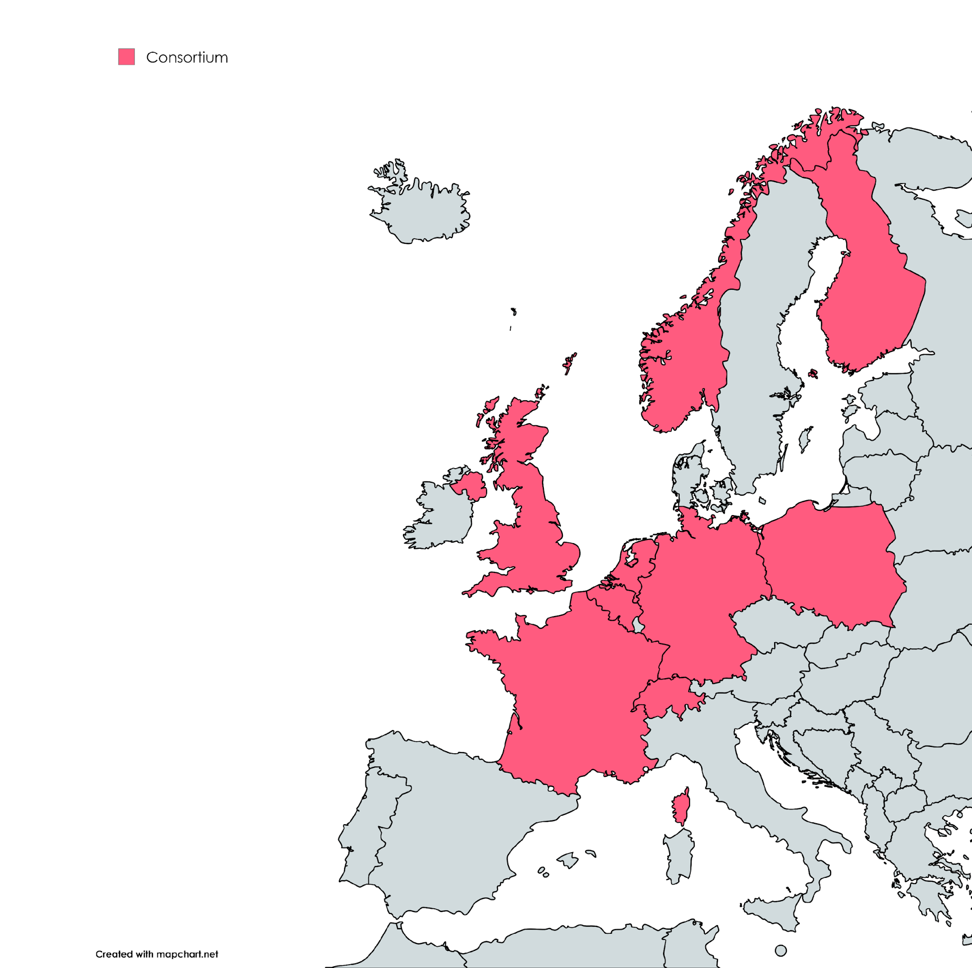


16 partners from nine countries with expertise in:
digital preservation
data quality
curation
FAIR data management and services
hosting of repositories and archives

Slide 23




 | eden-fidelis.eu
 | linkedin.com/company/eosc-eden
 | @eosc-eden.bsky.social
 | @EOSC-EDEN
Thank You
#EOSCEDEN
github.com/EOSC-EDEN
EOSC EDEN Zenodo Community

