Slide 1
FIDELIS in a Nutshell xxx
XXX

Slide 2
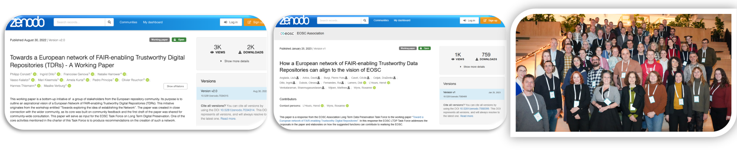
Project Background and Overview
Workshop
Working Paper
Working Paper
HORIZON-INFRA-2024- EOSC-01-03
Organised by FAIRsFAIR,EOSC Nordic and SSHOC to discuss how to sustain project efforts for repository support
“Towards a European Network of FAIR-enabling Trustworthy Digital Repositories (TDRs)”
Working Paper endorsed by the EOSC-A TF LTDP : such a network can unite the repository community beyond finite project efforts, offering coordination and networking mechanism
Idea becomes part of a Horizon funding call
Type of action : Coordination and Support Action (CSA)
Budget: 5M € (lump sum)
Duration:36 months
Coordinator: CSC, Finland
Project full title : FIDELIS - Establishing a European Network of Trustworthy Digital Repositories
Jan 2022
Aug 2022
2023
2024
2025
The FIDELIS project aims to further develop and implement the vision set by the community in this paper and establish, by the end of a three-year project, a healthy, vibrant and self-sustaining network of TDRs that will foster a supportive open science environment and guarantee FAIR data sharing also in the future.
https://zenodo.org/records/7034315
https://doi.org/10.5281/zenodo.7568400

Slide 3
Objectives
01
Set up a lean governance structure to establish and operate the Network
Build up a good membership base
Develop and test the value proposition of the Network
Provide common directionality and a common voice for digital repositories
Develop a common understanding of legal requirements of TDRs
Develop strategic partnerships and agreements with other initiatives
Set up, develop, and operate a European
network of trustworthy repositories that will support the development and growth of TDRs within the EOSC ecosystem
02
Develop a matrix of repository capabilities and characteristics
Recommend standards, APIs and solutions to facilitate access to resources, foster interoperability and allow cross-repository services
Facilitate the technical federation of repositories across EOSC
Foster harmonisation and interoperability across repositories to enable an EOSC
federation of TDRs
03
Identify training needs and support requests from digital repositories
Develop a comprehensive training and mentoring programme
Onboard new repositories in the Network
Disseminate and demonstrate the added value of the Network and its activities across EOSC
Strengthen the upskilling of repositories
and expansion of the Network through an active training and support programme

Slide 4
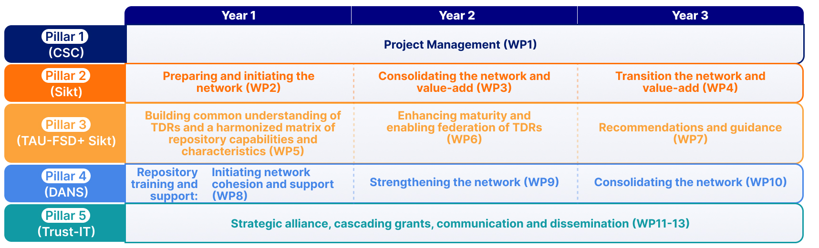
Work packages

Slide 5
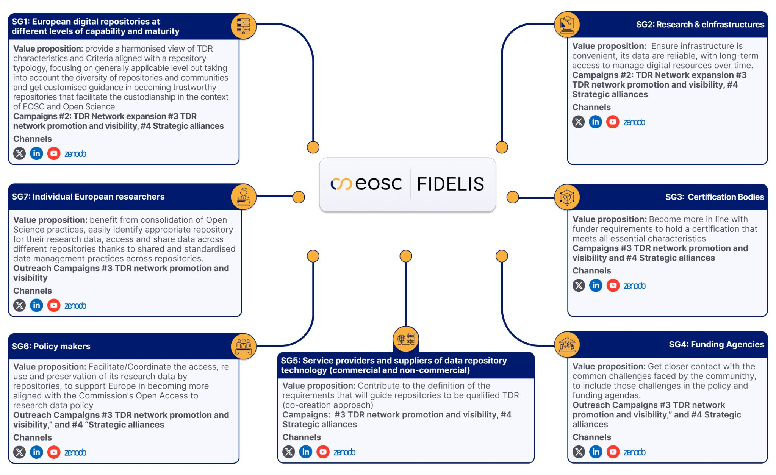
Stakeholders

Slide 6

















Consortium

Slide 7





info@fidelis-project.eu
Webpage
/company/fidelis-eosc/
@fidelis-eosc

