Slide 1
FIDELIS Project Overview 22nd of May,2025

Slide 2
Project Overview
Project full title | FIDELIS: Establishing A European Network of Trustworthy Digital Repositories
Acronym | FIDELIS
Call identifier | HORIZON-INFRA-2024-EOSC-01-03
Type of action | Coordination and Support Action (CSA)
Coordinator | CSC - IT Centre for Science
In June 2022, a group of renowned European repository owners and infrastructure providers published a working paper titled Towards a European network of FAIR-enabling Trustworthy Digital Repositories (TDRs), articulating a shared community vision to launch “a European network of FAIR-enabling Trustworthy Digital Repositories which will support the development and growth of TDRs”¹.
The paper, which received broad input from the community and was endorsed by the EOSC Task Force on Long Term Preservation, argues that such a network “can unite the repository community beyond finite project efforts, and offer a coordination and networking mechanism for addressing common challenges, like the need for long-term sustainability resources.”
The FIDELIS project aims to further develop and implement the vision set by the community in this paper and establish, by the end of a three-year project, a healthy, vibrant and self-sustaining network of TDRs that will foster a supportive open science environment and guarantee FAIR data sharing also in the future.
¹Conzett, Ph,, Dillo, I., Genova, F.,Harrower, N., Kalaitzi, V., Kleemola, M., Kurta, A., Principe, P., Rouchon, O., Thiemann, H., & Verburg, M.. (2022).
Towards a European network of FAIR-enabling Trustworthy Digital Repositories (TDRs) - A Working Paper (v2.0). Zenodo. https://doi.org/10.5281/zenodo.7034315.

Slide 3
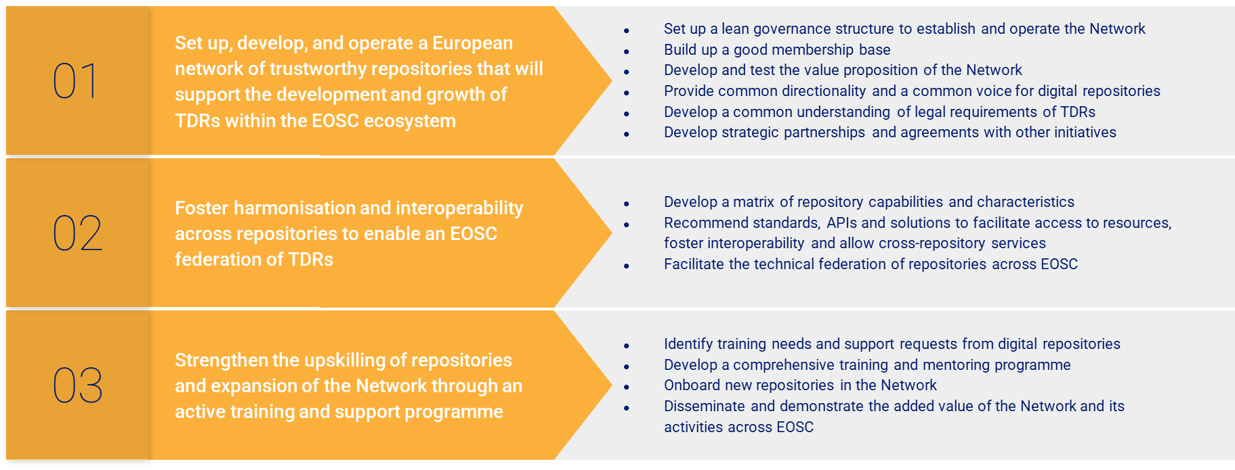
FIDELIS Objectives

Slide 4
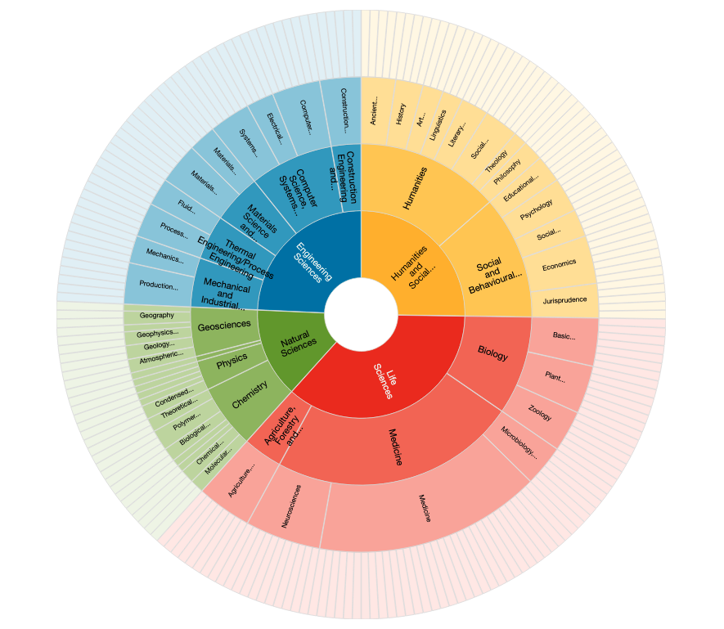
Building the European Network of Trustworthy Digital Repositories
“[...] Unite the repository community beyond finite project efforts, and offer a coordination and networking mechanism for addressing common challenges, like the need for long-term sustainability resources”
Towards a European network of FAIR-enabling Trustworthy Digital Repositories (TDRs) doi.org/10.5281/zenodo.7034315
Where do we start from?
re3data lists 296 in Europe
Six scientific communities are full partner and beneficiaries: CESSDA (Social Sciences), CLARIN (Linguistics), ELIXIR (Biomedical Sciences), INRAE (Agri-food), ESRF (Physical Sciences) and DKRZ (Climate Science).
FIDELIS partners' networks include over 200 active digital repositories
36 Early adopters and future members of the network
→ FIDELIS target: 50-80 engaged repositories to receive training, peer-to-peer mentoring and financial support to enhance their status as trustworthy repositories
FIDELIS ambition: to establish a healthy, vibrant and self-sustaining network of TDRs that
will foster a supportive open science environment and guarantee FAIR data sharing also in the future

Slide 5
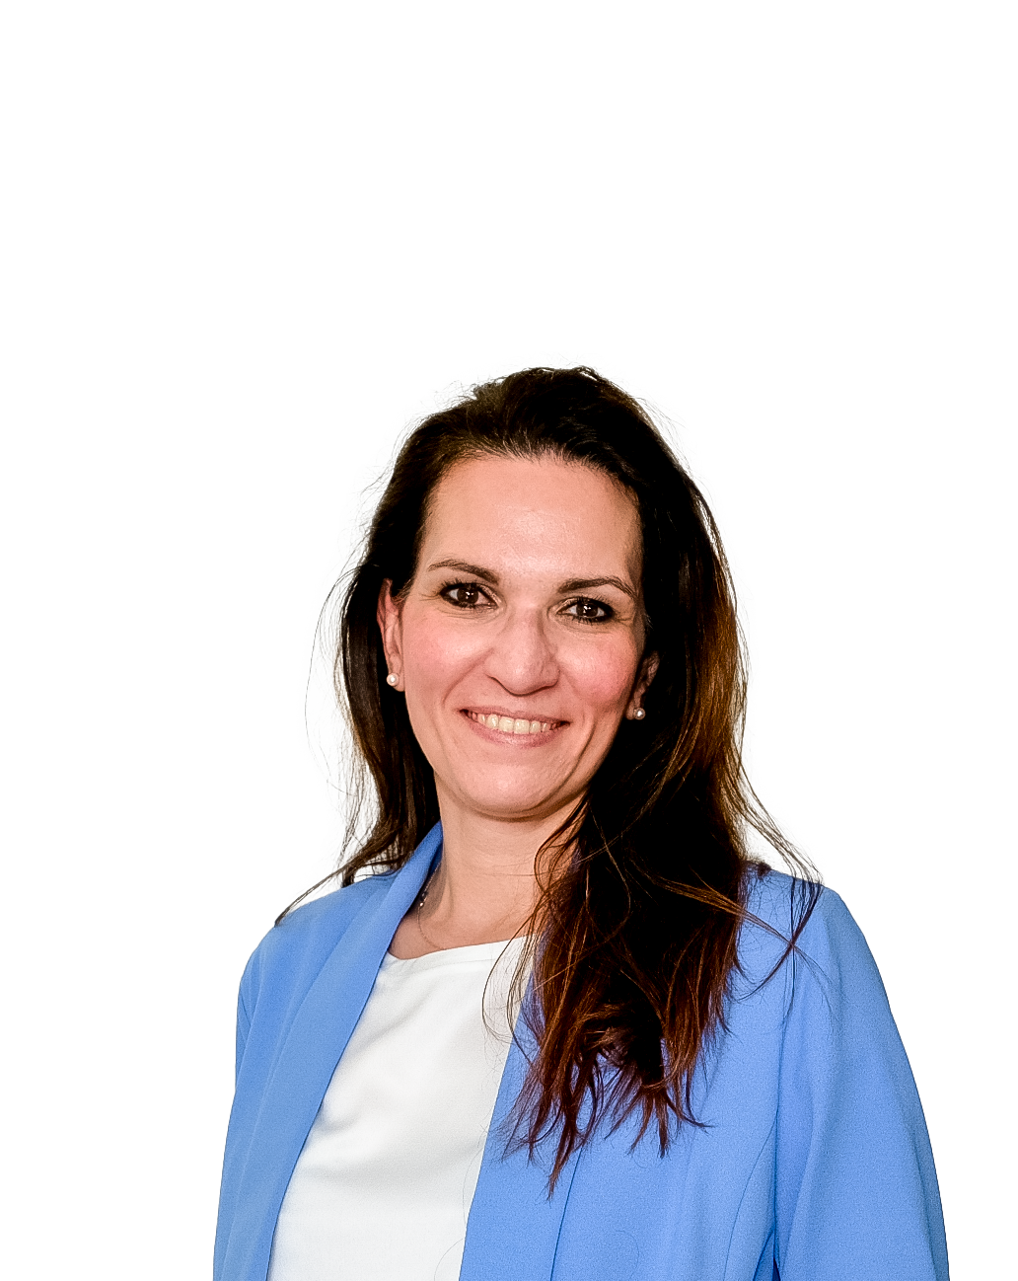
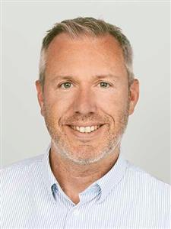
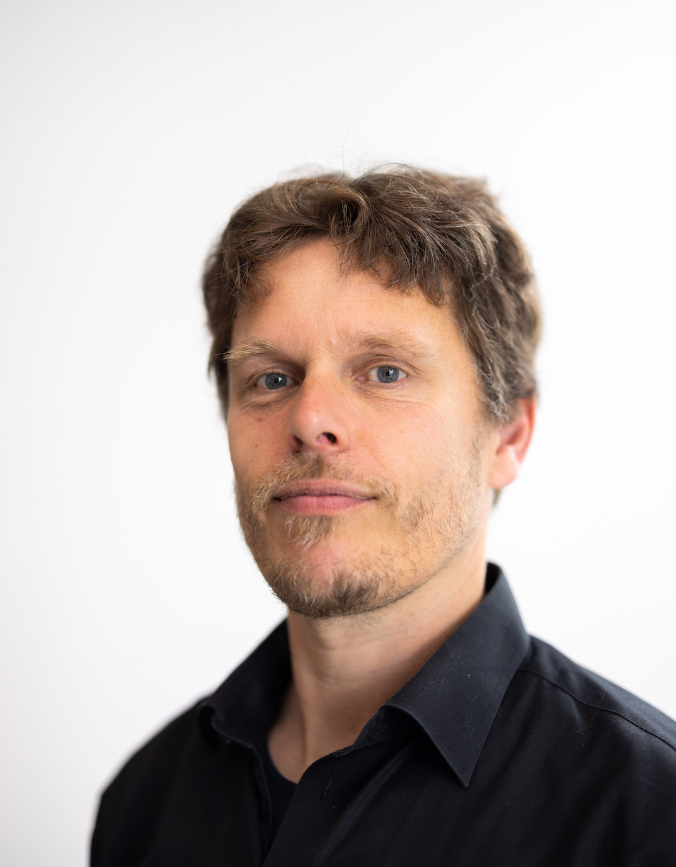
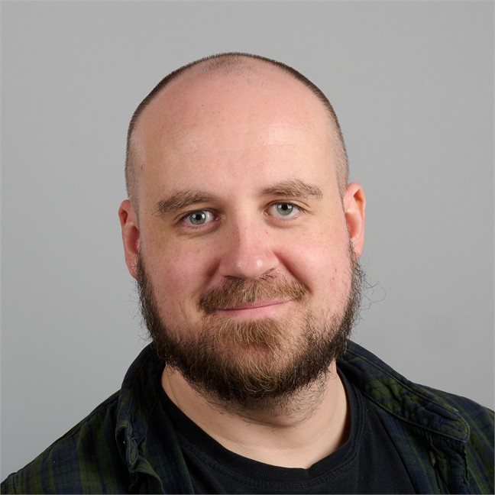
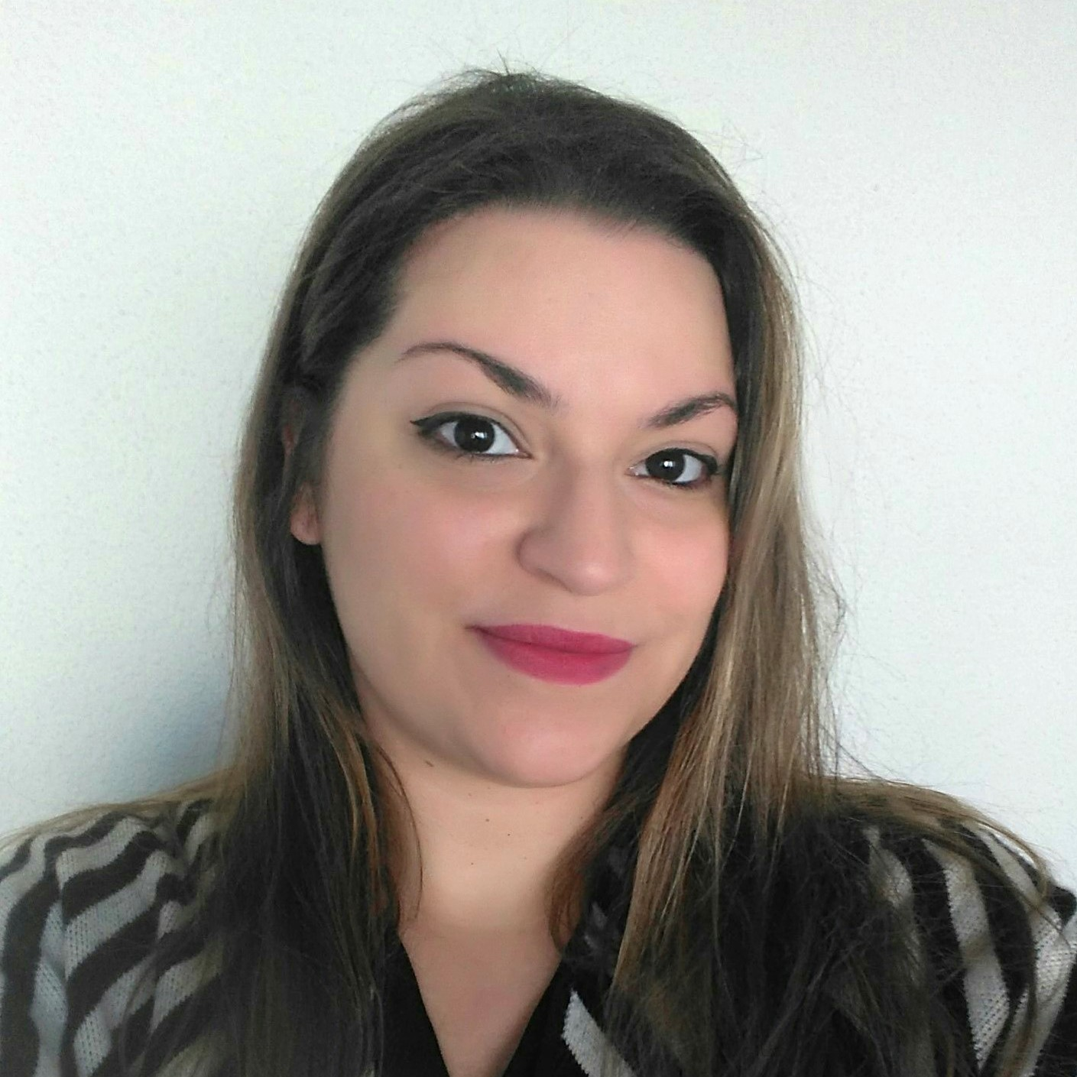
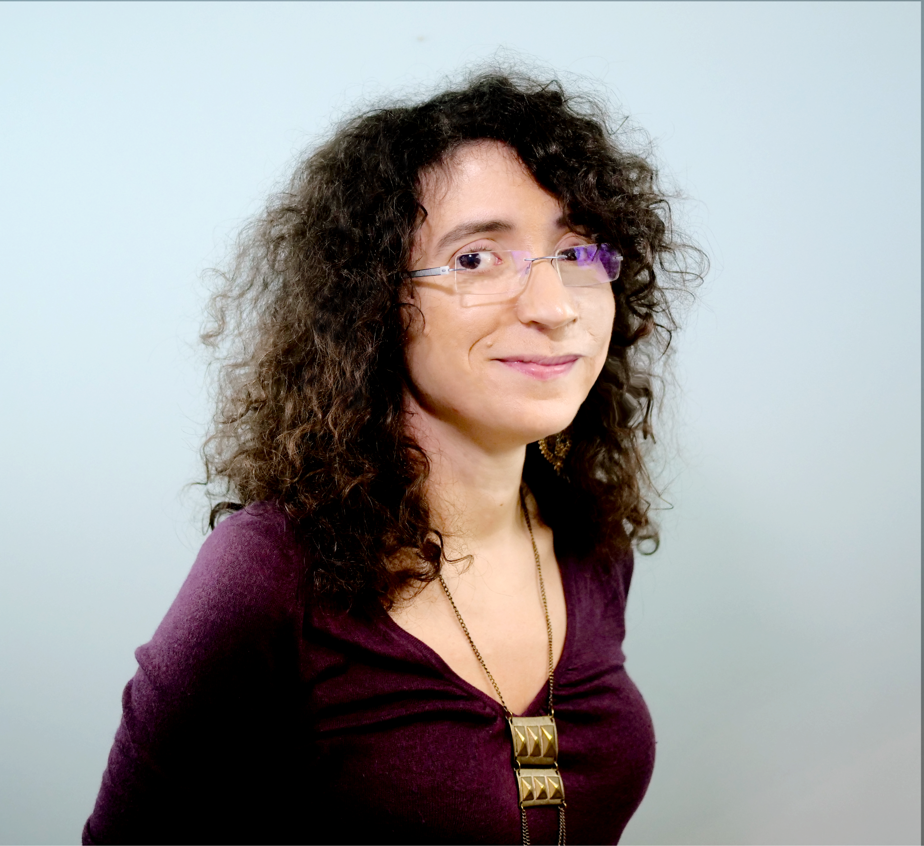
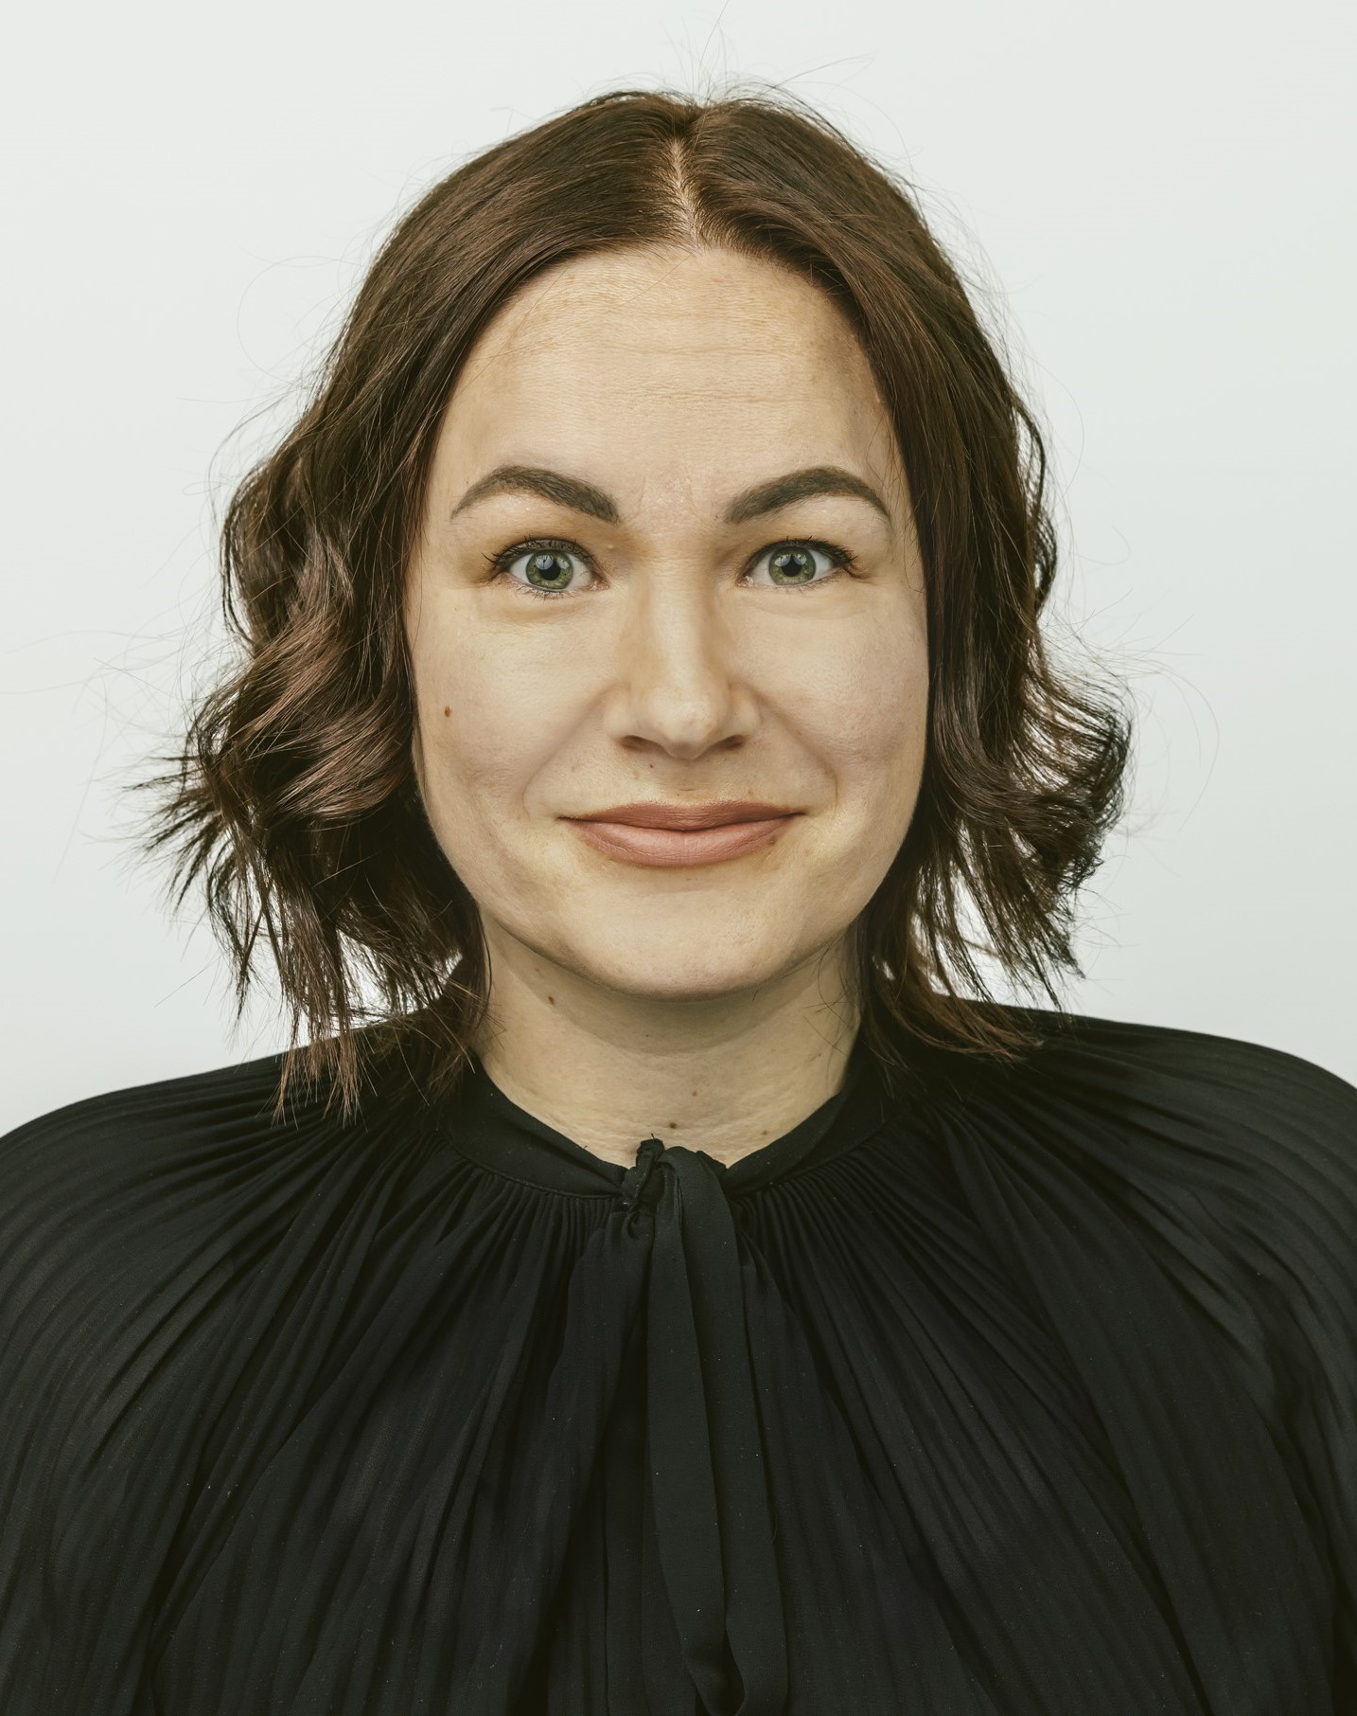
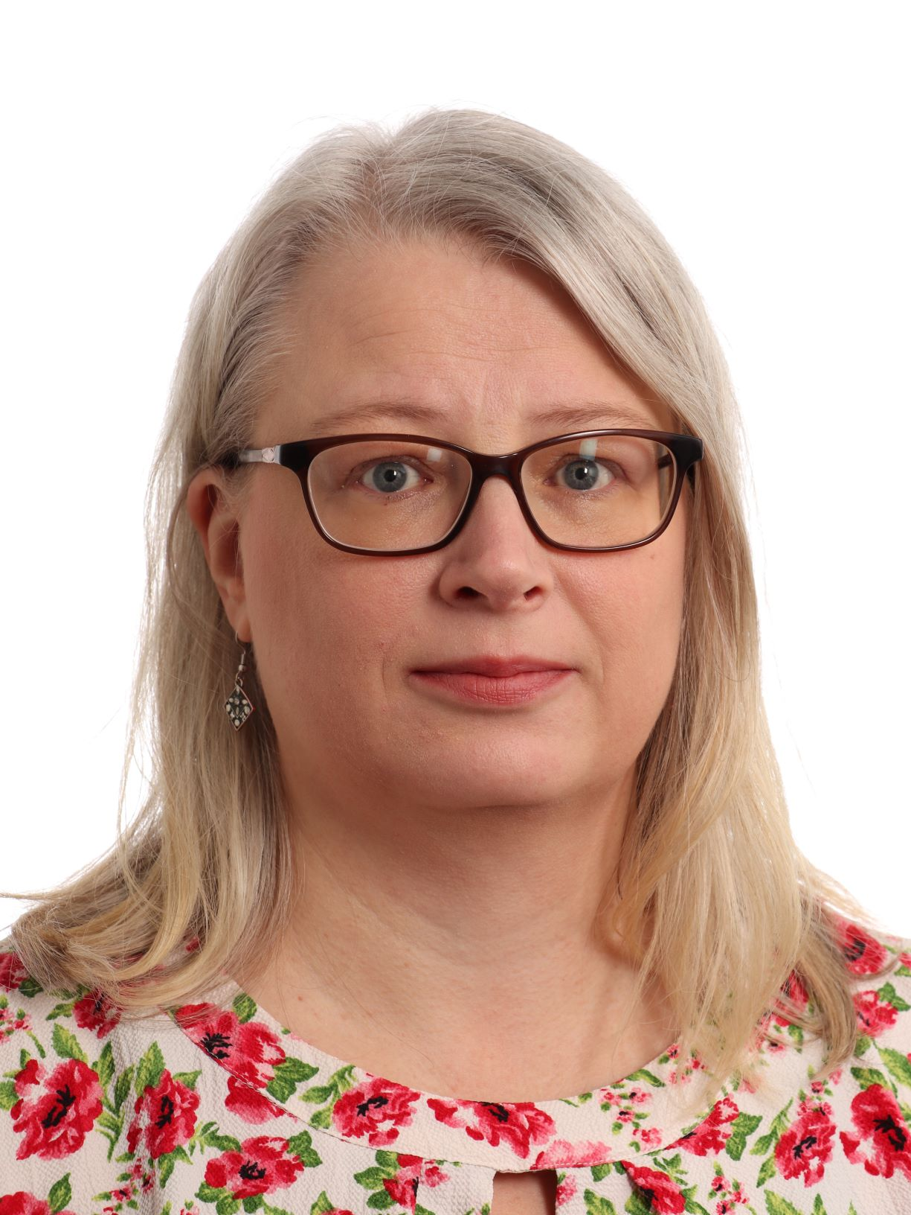
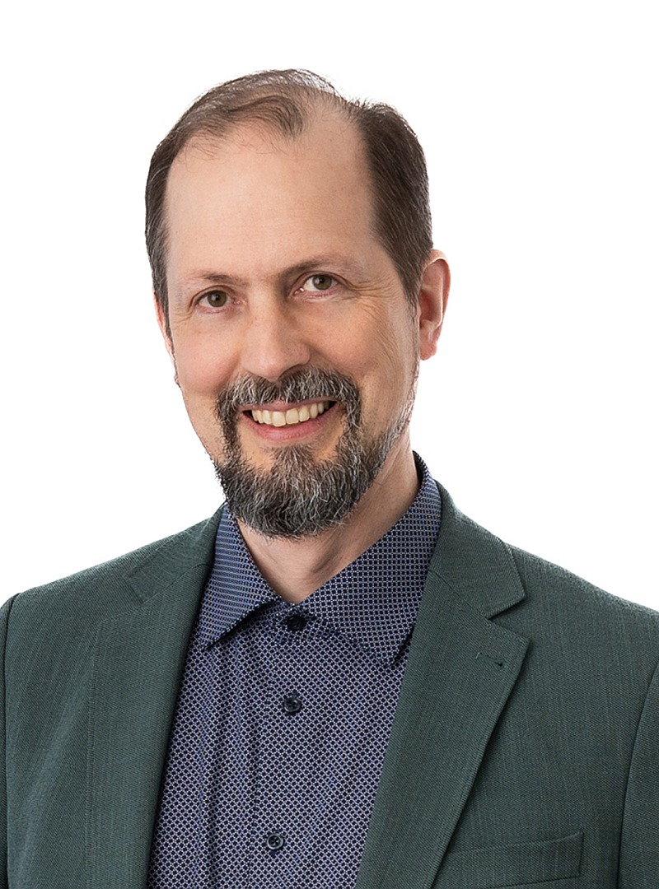
Structure of the project
Pillar 1:
Damien Lecarpentier (CSC))
Tarita Maraqa (CSC) / PMO
Pillar 2:
Pillar Lead: Jan Meijer (Sikt)
Deputy: Lisa de Leeuw (DANS)
Pillar 3:
Pillar Lead: Mari Kleemola (WP5-6 Lead)
Deputy: Tuomas J. Alaterä
WP7 Lead: Morten Jakobsen (Sikt)
WP7 Deputy: Lisa Tveit Sandberg (Sikt)
Pillar 4:
Pillar Lead: Maaike Verburg (DANS)
Deputy: Vasso Kalaitzi (DANS)
Pillar 5:
Pillar Lead: Sara Pittonet Gaiarin (Trust-IT)
Deputy: Rita Meneses (Trust-IT)
Lisa Tveit Sandberg
(TAU-FSD + Sikt)

Slide 6
Consortium
Coordinator

Slide 7
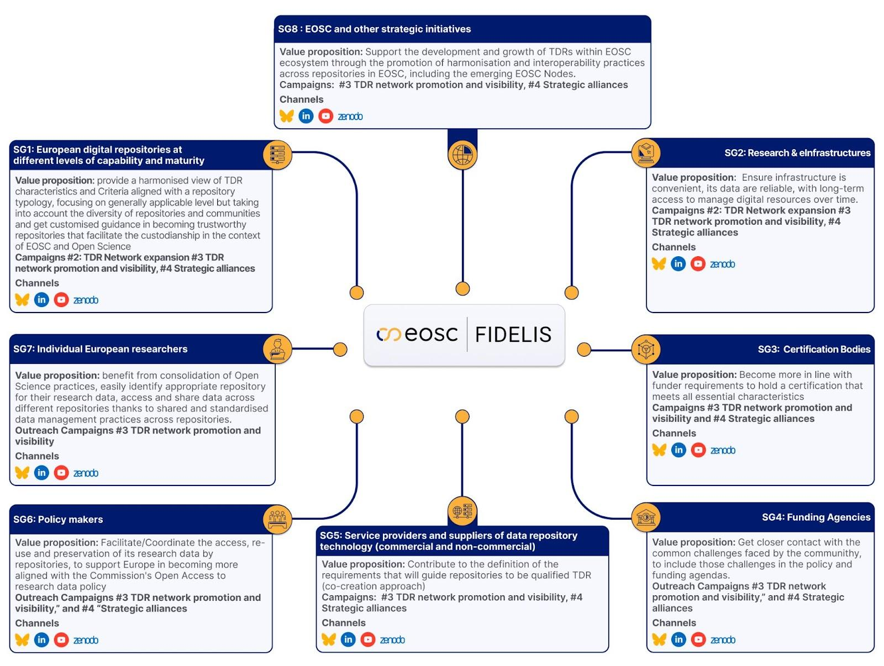
Stakeholders

Slide 8
Pillar 1: Project coordination and management (CSC)
Objectives
WP1
Y1-3
Carry out effective project management to ensure that the project meets its objectives.

Slide 9
Pillar 2: Network governance and value-add
Objectives
WP2
Y1
Establish the TDR Network with interim governance and onboard the first members.
Co-create sustainable business model and value-add activities for Network with TDR community
WP3
Grow membership base and agree with (aspiring) members on Network’s governance and strategy.
Test and evolve Network business models by providing value-add to members and aspiring members.
Achieve consensus with members and wider European TDR community on sustainability plan for Network (governance, resourcing, financing, value-add)
WP4
Ensure resources are in place to continue the Network in Y1 post-project.
Transition Network secretariat and online presence to post-project long term stability.
Further grow Network membership and provide Network governance and value-add.

Slide 10
Pillar 3: TDR harmonisation and interoperability
Objectives
WP5
Y1
Building common understanding of TDRs and a harmonised matrix of repository capabilities and characteristics.
WP6
Support repository benchmarking and achieve higher levels of capability and maturity.
Provide building blocks for technical and organisational federation.
Enhance the discoverability of repository capabilities and services, by easing machine interoperability between repositories and increasing alignment with use of registries.
WP7
Illustrate and develop guidance for use of the TDR capabilities and characteristics matrix.
Explore possibilities for semantic interoperability and make recommendations for the TDR Network tasks in this area.
Assess and propagate harmonised use of semantic artefacts for TDRs within the Network.

Slide 11
Pillar 4: Training and Support
Objectives
WP8
Y1
Identify repositories’ support and training needs.
Establish collaboration with relevant initiatives for support and training of repositories.
Develop and test a comprehensive training and support programme.
WP9
Strengthen the European Network of trustworthy repositories through active support, peer-to-peer mentoring and training.
WP10
Consolidate the European Network of trustworthy repositories through the final cycle of support and training.

Slide 12
Pillar 5: Communication & outreach
WP11
Y1
Objectives
Establish contacts and introduce collaboration mechanisms to ensure dialogue with the EOSC Partnership and the broad network of data-intensive projects, initiatives and research infrastructures in Europe and beyond.
Design the overall strategy for dissemination, communication and engagement of the project at all levels. Setting up TRUST-GRANTS™ platform to administer the cascading calls in WP9 and WP10.
WP12
Implement and consolidate the interaction with the EOSC Partnership and other strategic initiatives started in the previous period and support WP3, WP6 and WP9 in their stakeholder engagement efforts through coordination within the project.
Facilitate working collaborative practices among repositories via a dedicated Forum. Ensure visibility and promotion to the training programme and open calls.
WP13
Ensuring visibility and promotion to the training programme and open calls.
Position the Network as the voice of the trustworthy digital repositories´ community and consolidate its role as a key reference in the Open Science landscape in Europe, in collaboration with WP4, WP7, WP10.
Ensure proper handover from the project to the Network in terms of continuity of relationships and collaboration with the EOSC Partnership and strategic initiatives.

Slide 13
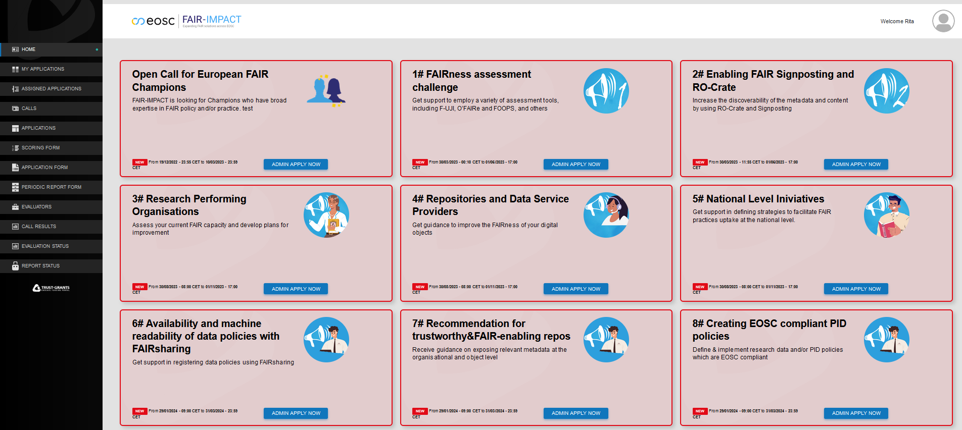
Open calls management: the Grants platform
Online tool to accompany users throughout their application process, to follow the process of FIDELIS open calls for mentors & cascading grants support:
Monitor the work behind each grant
Manage applications & evaluators
Manage evaluations & scores
Control periodic reports
Collaboration with Pillar 4
Numbers to keep in mind
50-80 repositories and max 40 external mentors to be selected through 2 open calls for projects and 2 for mentors
700k € available, indicatively 200k for mentors and 500k for adopters
Open call launch & results pages on the FIDELIS website, along with FAQs, to provide clear information;
Single Sign On
A streamline grant management process to improve overall efficiency, transparency and reporting, to ensure right decisions on selection process are made for a strong EU network of highly motivated repositories

Slide 14
FIDELIS Network of Trusted Digital Repositories
FIDELIS Network was launched with the aim of supporting digital repositories in Europe to become and remain trustworthy over time.
FIDELIS welcomes digital repositories that practice or aspire to practice TRUST-inspiring and FAIR-enabling ways of working to join the network!
Digital Repository Name | Institution
FiVeR | Institute of Field and Vegetable Crops
Austrian NeuroCloud | Universitat Salzburg, Faculty of Natural and Life Sciences
Lithuanian Data Archives | Kaunas University, Faculty of Social Science Arts and Humanities
DAIS | Digital Archive of the Serbian Academy of Sciences and Arts
The Language Bank of Finalnd | Department of Digital Humanities
This is a snapshot of the latest Network sign-ups, after the attendance of the webinar. The current provisional members of the Network span across Europe and fields of expertise.
The launch of TDR Network garnered interest amongst 76 attendees at the introductory webinar. We presented the Network’s roadmap, vision, and the benefits of joining the Network for early adopters.
27 Repositories signed up to join the TDR Network so far.
Interested in joining the TDR Network? Sign up now.

Slide 15
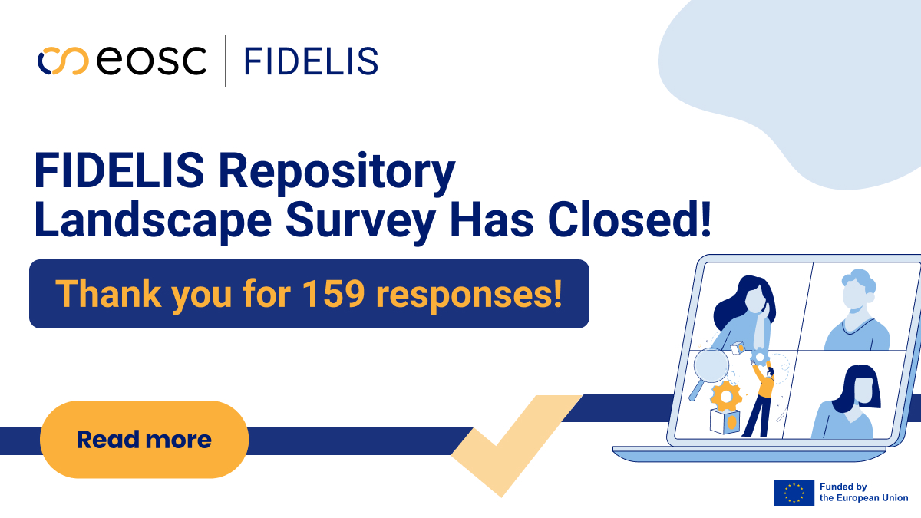
FIDELIS Landscape of Digital Repositories
In order to address the needs and foster harmonisation across repositories, FIDELIS project also released a landscape survey.
The results of the survey analysis will become publicly available at the end of June.
The survey considered topics related to:
Different implemented standards
Challenges in the areas of digital object management
Legal topics
Organisational infrastructure
Technology and security
Training and support needs of repositories.

Slide 16
Next in our calendar
FIDELIS consortium is planning several events and updates for the repository community, including :
1) FIDELIS TTRAM Introductory Webinar on harmonisation efforts in repository landscape
17th of June, 2025 at 12:00 CEST
Registration open soon!
2) Landscape Analysis Publication (end of June)
3) First meeting for the members of the TDR Network (early July)
Don’t miss upcoming opportunities from the FIDELIS and EDEN Communities. Sign up to our newsletter!

Slide 17
CORDIS webpage
/company/fidelis-eosc/
@fidelis-eosc

