Slide 1


EOSC EDEN
Enhancing Digital preservation strategies at European and National level
Grant agreement 101188015

Slide 2
EOSC EDEN Objectives
Objective 1: To establish a general framework and practices to support the creation of curation, long-term preservation, and access strategies in Europe
Objective 2: To enrich EOSC with tools to store and access digital data for long periods, automate and federate certain specialised curation and preservation tasks
Objective 3: To increase adoption of curation, long-term preservation and access practices within different scientific disciplines
Objective 4: To boost the data curation and quality in Europe
Objective 5: To identify and consolidate a network of repositories and archives for long-term preservation within EOSC in collaboration with the HORIZON-INFRA-2024-EOSC-01-03 awarded project i.e. FIDELIS

Slide 3
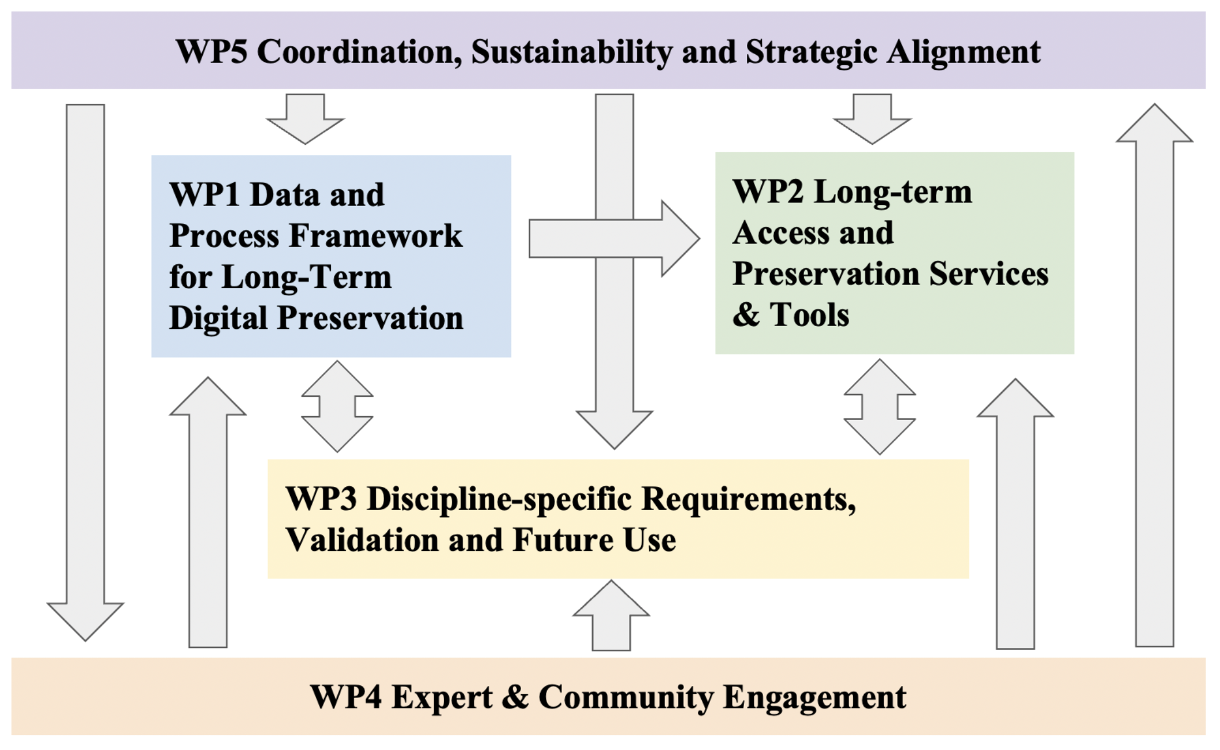
Project Structure and Work Packages

Slide 4
EOSC EDEN Impact
Specific project impacts
Increased awareness and implementation of preservation practices and standards in Europe
Practices, standards and tools for long-term preservation are mainstreamed in the EOSC ecosystem
Advance the establishment of the EOSC Federation by supporting the emergence of a European distributed infrastructure for long-term preservation, curation and access
Raise temporal aspects of FAIR on the agenda of funders and policy makers
The skills in long-term data preservation, data quality, and curation among the European scientific community are significantly enhanced

Slide 5



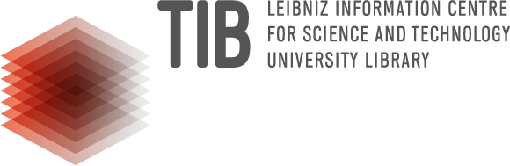










EOSC EDEN Consortium

Slide 6


 | eden-fidelis.eu
 | linkedin.com/company/eosc-eden
 | @eosc-eden.bsky.social
 | @EOSC-EDEN
Thank You

